Slide 1


DEPARTMENT OF MECHANICAL ENGINEERING
MINOR PROJECT REVIEW

Slide 2
MINOR PROJECT
TEAM MEMBERS :
SATHYARAJ.M (927622BME081)
SAVEEN.R (927622BME082)
MENTOR:
Dr.S.Dhanabalan

Slide 3
BAG LIFTING MACHINE

Slide 4
INTRODUCTION
.
The bag lifting machine is designed to simplify and streamline bag handling operations.It addresses the physical strain and potential injuries associated with manual lifting.
This machine provides an ergonomic solution for industries requiring frequent bag handling.Its compact design and lightweight construction facilitate easy maneuverability.
The manual bag lifting machine is ideal for warehouses, distribution centers, and manufacturing facilities.It efficiently lifts and sturdy steel frame and durable components ensure long-term reliability.

Slide 5
ABSTRACT
The bag lifting machine is a mechanical device designed to lift and transport heavy bags, reducing manual labor and workplace injuries. With a lifting capacity of up to 50 kg, this machine utilizes a mechanical advantage system, ergonomic handle, and adjustable height to ensure efficient and safe operation.

Slide 6
DSCRIPTION OF THE PROJECT
Aim of the project is to reduce the human efforts in lifting the object or bag and instead of using hydraulic and automatic lifting machine
It easy to carry and cost is economy in this bag lifting machine which make affordable to handle this machine
The manual bag lifting machine is a cost-effective, ergonomic solution designed to simplify and streamline bag handling operations.
This machine reduces manual lifting injuries and improves productivity in warehouses, distribution centers, and manufacturing facilities.

Slide 7
WORKING
The manual bag lifting machine is a simple, yet efficient, device designed to reduce the strain and effort required to lift and transport heavy bags. Its operation involves a combination of mechanical advantage and ergonomic design. Bag Placement
The user places the bag onto the machine's platform or cradle, typically located at a low height for easy loading. The user secures the bag using adjustable straps or grips, ensuring a stable and safe hold. Using the ergonomic handle, the user applies a gentle pulling force to lift the bag. The machine's mechanical advantage system, often utilizing pulleys or levers, amplifies the user's effort, making it easier to lift heavy loads.
The user releases the bag by loosening the straps or grips. allowing it to rest securely at the new location.

Slide 8
OBJECTIVE OF PROJECT
“Design a compact, efficient portable bag lifting machine to simplify material handling, reduce physical strain, and improve productivity in various environments, ensuring ease of use and reliability”

Slide 9
MATERIAL REQUIRED
Mild Steel
wheel
Rectangle rod
Circular rod
sheet matel

Slide 10
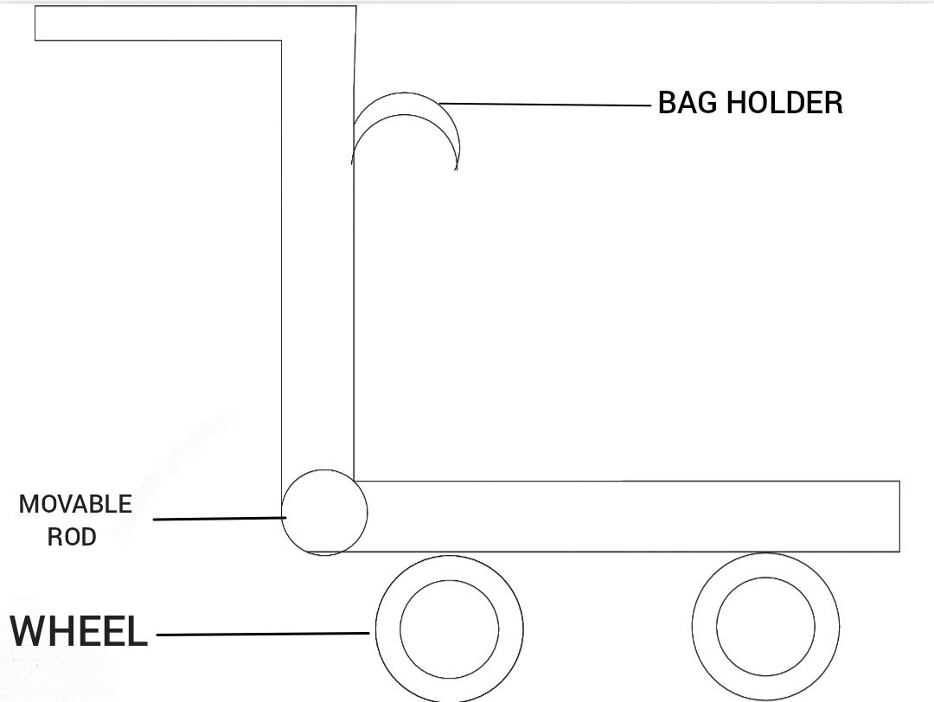
LAYOUT DIAGRAM
LAYOUT DIAGRAM

Slide 11
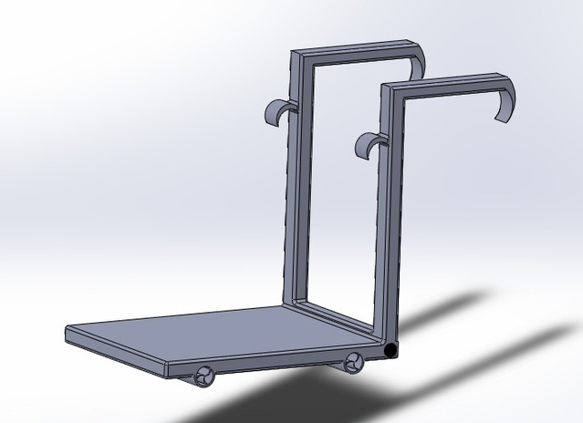
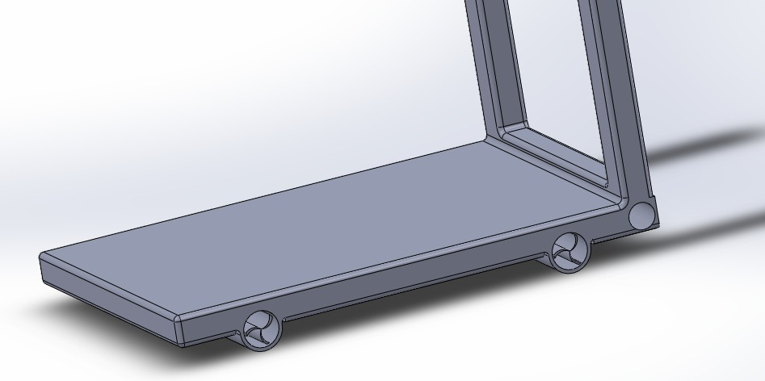
LAYOUT DIAGRAM (3D)

Slide 12
ADVANTAGES
Require less effort to lift heavy loads.
This can help to reduce the risk of injury to workers and
Increase productivity in industrial settings.
Increases the speed of work. Reduces time consumption.

Slide 13
COST ESTIMATION
S.NO | DISCRIPTION | COST RS
1 | RECTANGULAR ROD | 400
2 | FRAME | 900
3 | WHEEL | 1000
4 | SHEET METAL | 800
5 | CIRCULAR ROD | 200
6 | HOOKS | 600
 | TOTAL | 3900

Slide 14
APPLICATION
various industries to make it easier to move heavy and bulky bags palletizing, lifting and lowering or transporting sacks
It easier to handle heavy sacks in various inhouse transport and handling processes.
Uses in company where transport of cement bag and rice bag and etc

Slide 15
THANK
YOU

